Slide 1
Numeral System Cont’d
Mina Gabriel

Slide 2
Hexadecimal Numbers
With hexadecimal numbers we have the number 16 for a system base, which implies the use of 16 digits to represent all possible values from 0 to 15 inclusive.
for notating numbers in the hexadecimal system, we use the digits from 0 to 9 and the Latin numbers from A to F. Each of them has the corresponding value:
A=10, B=11, C=12, D=13, E=14, F=15

Slide 3
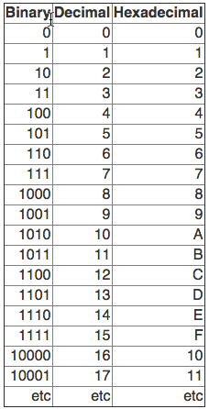

Slide 4
Why Hexadecimal?
Binary is an effective number system for computers because it is easy to implement with digital electronics. It is inefficient for humans to use binary, however, because it requires so many digits to represent a number.
The number 76, for example, takes only two digits to write in decimal, yet takes seven digits to write in binary (1001100).
To overcome this limitation, the hexadecimal number system was developed. Hexadecimal is more compact than binary but is still based on the digital nature of computers.

Slide 5
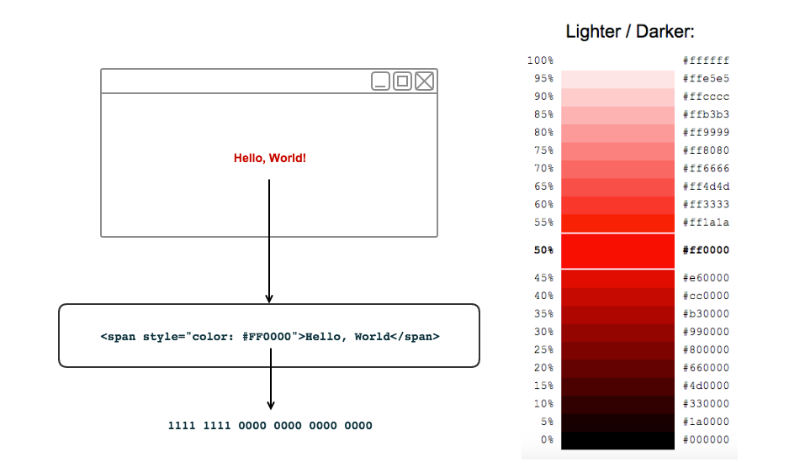
Hexadecimal examples
CSS color data type can be represent as Hexadecimal notation:

Slide 6
Hex to decimal
Transition to decimal system is done by multiplying the value of the right most digit by 160, the next one to the left by 161, the next one to the left by 162 and so on, and adding them all up in the end. Example:

Slide 7
Exercise
Convert the following hexadecimal numbers to decimal:
FA
2A3E

Slide 8
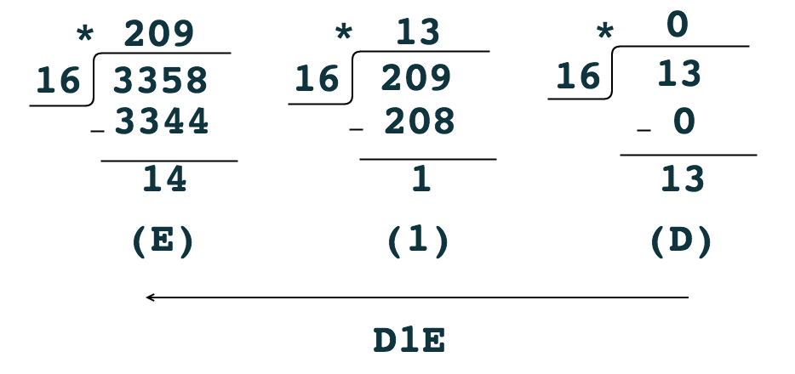
Decimal to Hex
Transition from decimal to hexadecimal numeral system is done by dividing the decimal number by 16 and taking the remainders in reverse order. Example:
convert 3358 to Hex :

Slide 9
Exercise
Convert the following Decimal numbers to Hexadecimal:
1024
473

Slide 10
Fast Transition from Binary to Hexadecimal Numbers
The fast conversion from binary to hexadecimal numbers can be quickly and easily done by dividing the binary number into groups of four bits (splitting it into half-bytes).
If the number of digits is not divisible by four, leading zeros in the highest-orders are added.
After the division and the eventual addition of zeros, all the groups are replaced with their corresponding digits.

Slide 11
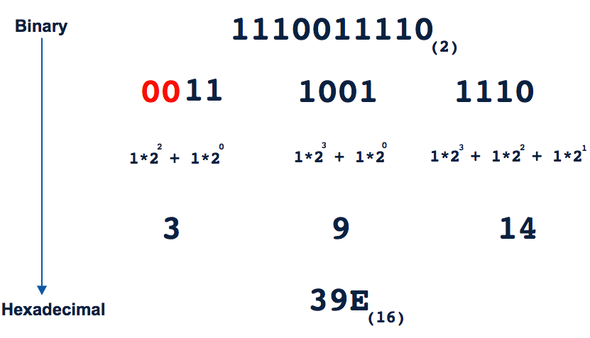
Let’s look at the following: ${1110011110}_{(2)}$

Slide 12

Exercise
Convert the following binary numbers to Hexadecimal:
${\text{01001110}}_{(2)}$
${\text{011101}}_{(2)}$

Slide 13
Numeral Systems - Summary
As a summary, we will formulate again in a short but clear manner the algorithms used for transitioning from one positional numeral system to another:
Transitioning from a decimal to a k-based numeral system is done by consecutively dividing the decimal to the base of the k system and the remainders (their corresponding digit in the k based system) are accumulated in reverse order.

Slide 14

Transitioning from a k-based numeral system to decimal is done by multiplying the last digit of the k-based number by $k^{0}$, the one before it by $k^{1}$, the next one by $k^{2}$and so on, and the products are the added up.

Slide 15
Transitioning from a binary to hexadecimal numeral system and back is done by converting each sequence of 4 binary bits into its corresponding hexadecimal number and vice versa.

